Slide 1




Agentic AI with watsonx and ABP
#let’s create
watsonx Orchestrate

Slide 2

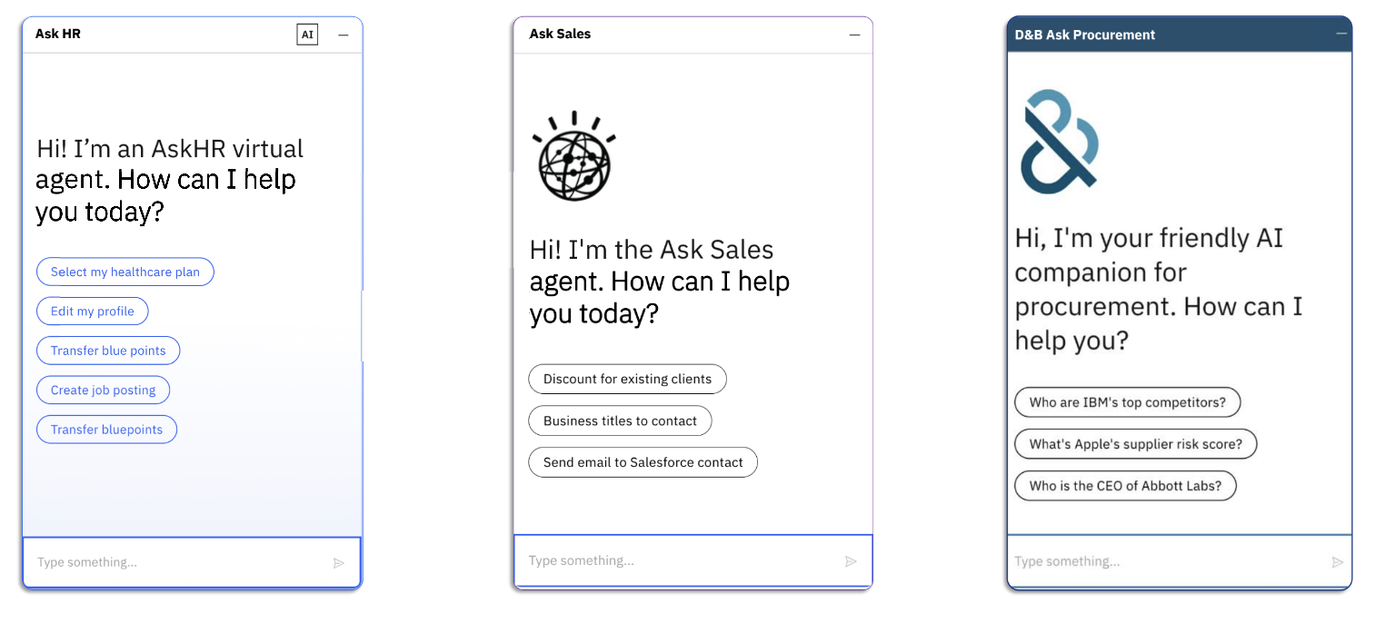
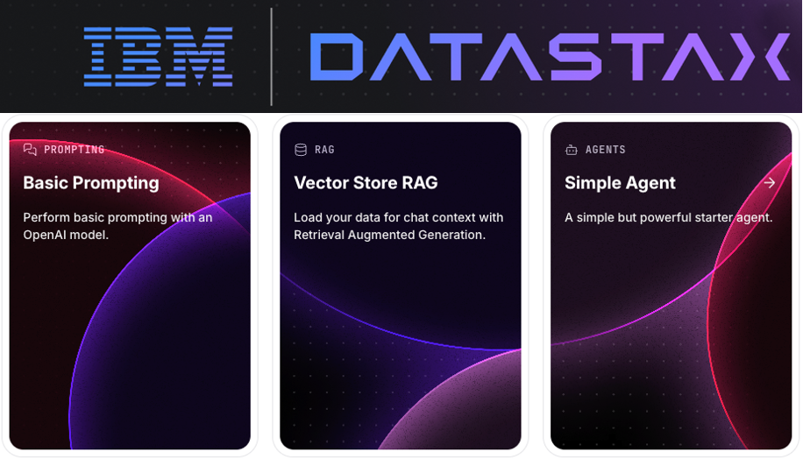














watsonx Orchestrate
Prebuilt IBM’s Agents
Build your own Agent
HR Sales Procurement
External Partner’s Agents & Tools
Agentforce
Compensation agent
Support Analysis Agent
Salesforce SDR Agent
watsonx
Granite

Slide 3

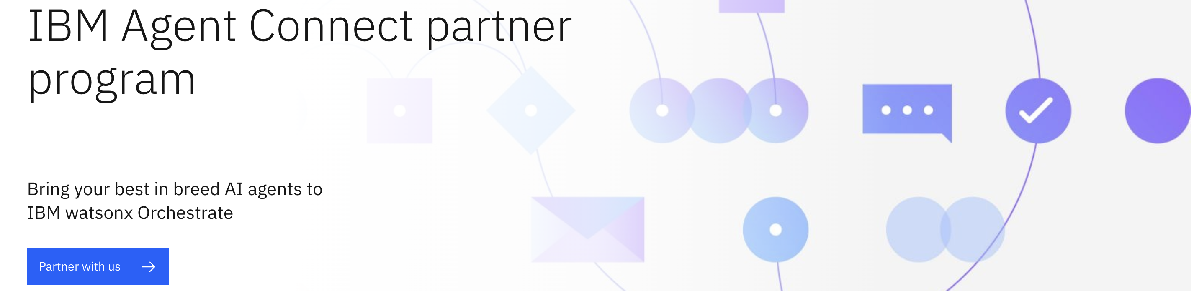
Build Agent & Connect

Slide 4
Agenda of the use case
- Introduce Orchestrate UI (the catalog and built-in agents)
- Developing custom agents:
- Policy Agent - Orchestrate UI, Enterprise documents
- Travel Planning Agent – Langflow + MCP server
- HR Agent that works along with the above agents

Slide 5
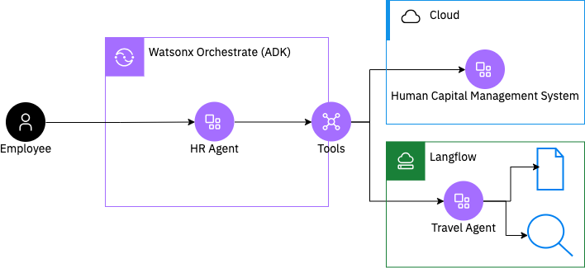

Today’s use-case: Travel + HR agents

Slide 7
Build Agent & Connect

